Slide 1
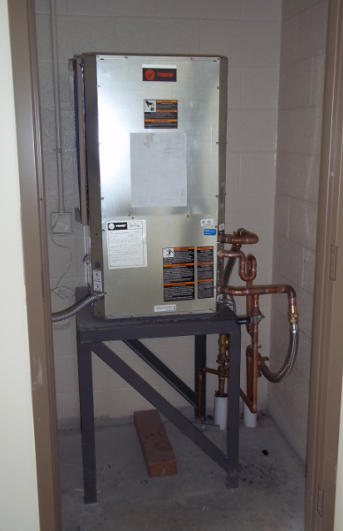
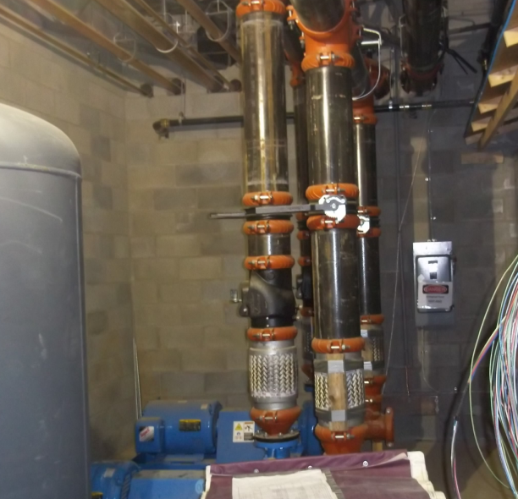
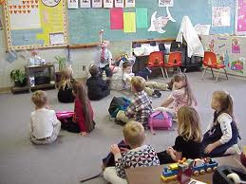

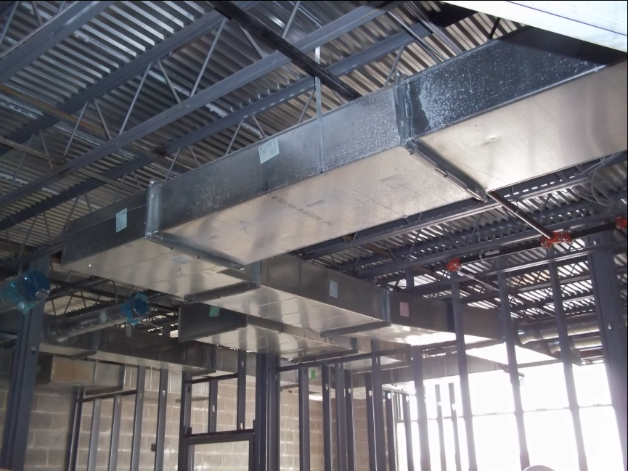
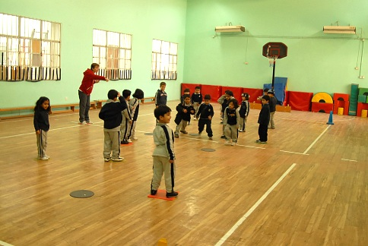
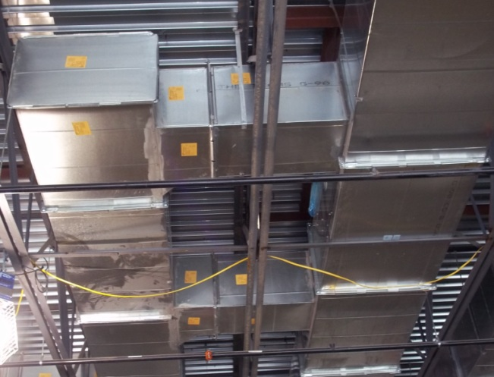
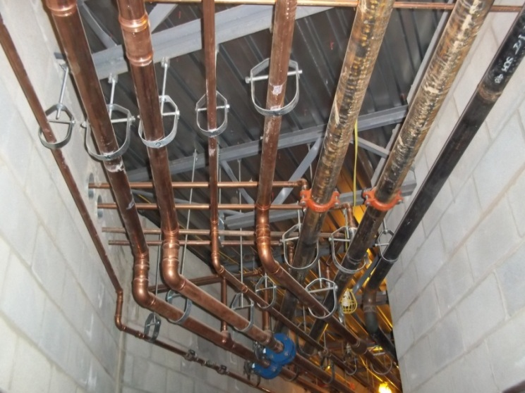
The Sunshine Elementary School
Redesign Proposal
Pennsylvania State University
AE Senior Thesis
Nicholas Scheib
Mechanical Option- IP

Slide 2
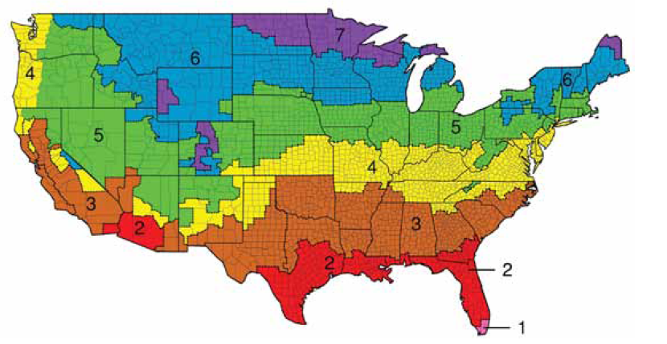
The Sunshine Elementary School is located in Climate Zone 5. The design has met all ASHRAE requirements of this climate zone.
General Information of Project
Size- 103,000 Square Feet
2 Levels
Overall Cost- $16,599,000
Brick Facade
Gable Roofs
Construction Dates- March 2010- June 2011
Silver LEED Accreditation Goal
Presentation Outline
Project Overview
Existing Conditions
Depth
  Radiant Heating and Cooling
  Low Velocity Displacement Ventilation
Breadths
  Daylighting
  Acoustics
Overall Cost
  Initial Difference
  LCC
Pros versus Cons
ASHRAE Climate Chart (Fundamentals, 2009)

Slide 3
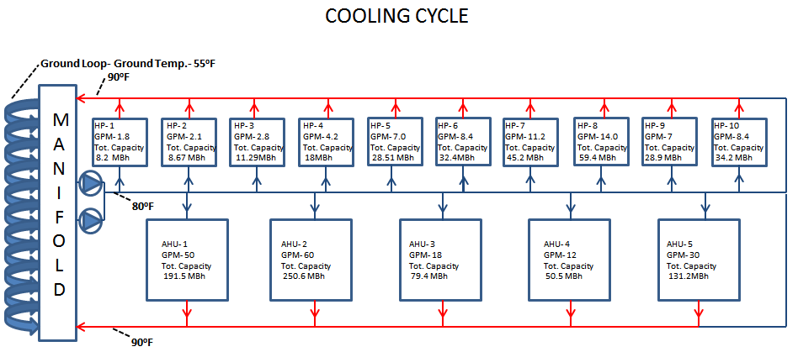
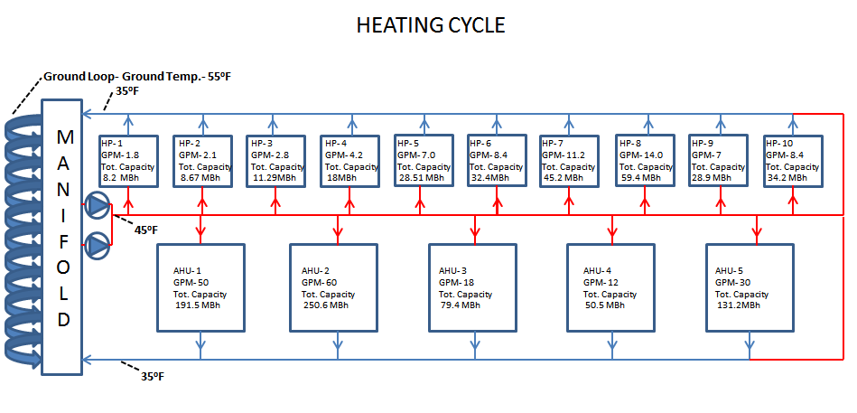
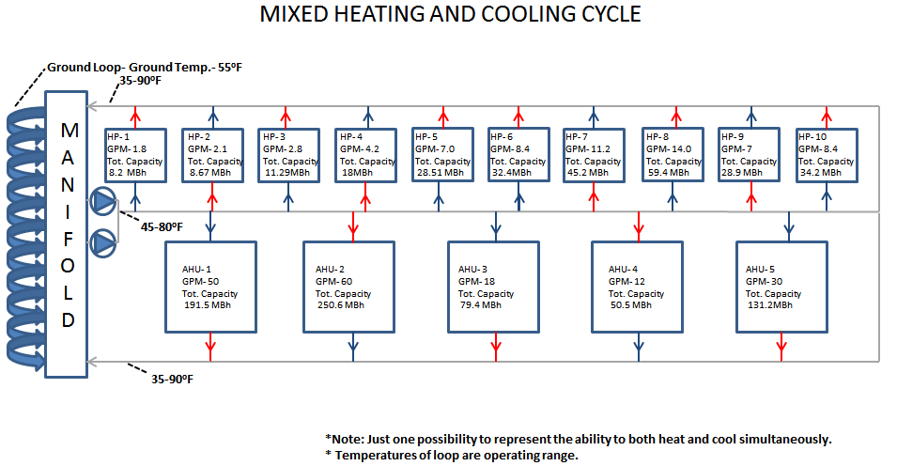
Original Design Components
144 Vertical Geothermal Wells- 12 x 12 grid
Water-to-Air Heat Pumps- each room
Energy Recovery Units
CO₂ Sensors
AHU’s for gym and cafeteria
eQuest© Energy Model- LEED approved
  42% more efficient then Baseline Model
Water-to-Air Heat Pumps Tied to Ground Loop
Presentation Outline
Project Overview
Existing Conditions
Depth
  Radiant Heating and Cooling
  Low Velocity Displacement Ventilation
Breadths
  Daylighting
  Acoustics
Overall Cost
  Initial Difference
  LCC
Pros versus Cons

Slide 4
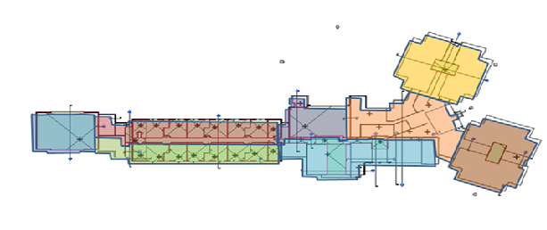
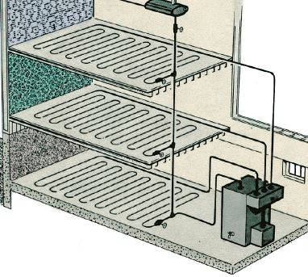
Radiant heating and cooling was designed in the gymnasium, 1st through 5th grade classrooms and kindergarten classrooms.
Presentation Outline
Project Overview
Existing Conditions
Depth
  Radiant Heating and Cooling
  Low Velocity Displacement Ventilation
Breadths
  Daylighting
  Acoustics
Overall Cost
  Initial Difference
  LCC
Pros versus Cons
Radiant Heating and Cooling
Enough Capacity?

Slide 5
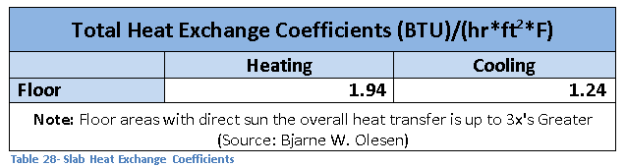
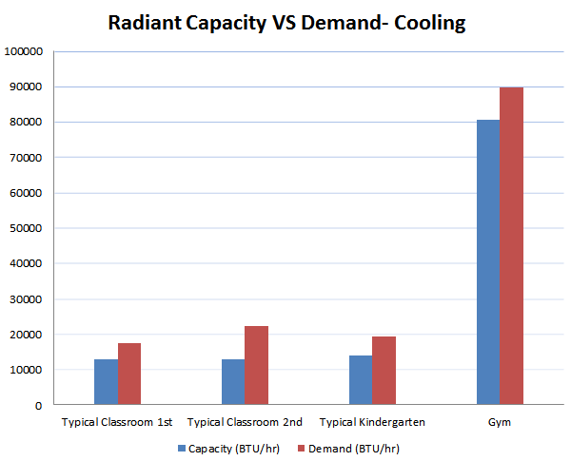
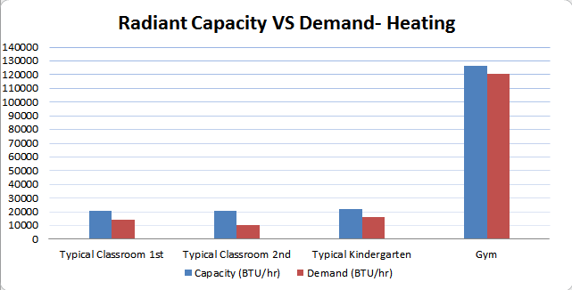
Using coefficients found by Bjarne W. Olesen the Radiant heating and Cooling capacities were found.
The cooling Capacity of a radiant slab is less then that of heating.
Presentation Outline
Project Overview
Existing Conditions
Depth
  Radiant Heating and Cooling
  Low Velocity Displacement Ventilation
Breadths
  Daylighting
  Acoustics
Overall Cost
  Initial Difference
  LCC
Pros versus Cons
Radiant Capacity = Coefficient* Floor Area * ∆T

Slide 6
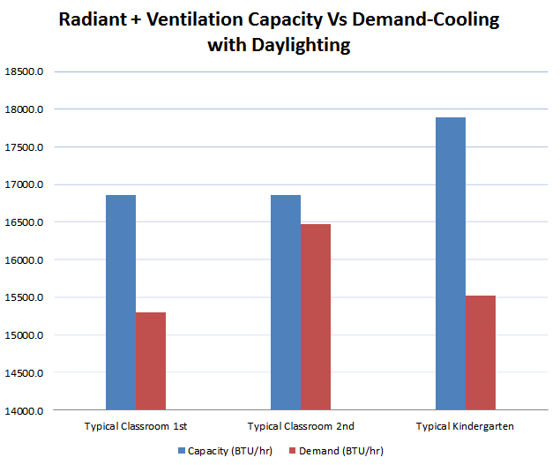
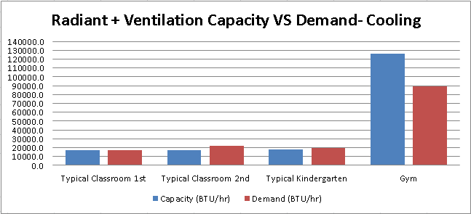
Conditioning Ventilation air will increase the system capacity but will prove to still not be enough.
Radiant Capacity + (1.08 x CFM x ∆T) = Total Capacity
By adding daylighting controls to the building the peak cooling demand is now met.
Presentation Outline
Project Overview
Existing Conditions
Depth
  Radiant Heating and Cooling
  Low Velocity Displacement Ventilation
Breadths
  Daylighting
  Acoustics
Overall Cost
  Initial Difference
  LCC
Pros versus Cons

Slide 7
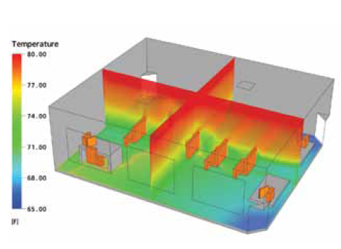
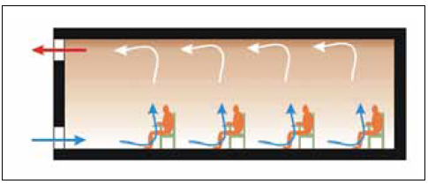
Low Velocity Displacement Ventilation couples well with radiant systems by increasing the stratification of the space.
The combined effect of radiant systems and low velocity displacement ventilation treats the load where the demand is located.
Presentation Outline
Project Overview
Existing Conditions
Depth
  Radiant Heating and Cooling
  Low Velocity Displacement Ventilation
Breadths
  Daylighting
  Acoustics
Overall Cost
  Initial Difference
  LCC
Pros Versus Cons
(Price, 2007)
(Price, 2007)

Slide 8
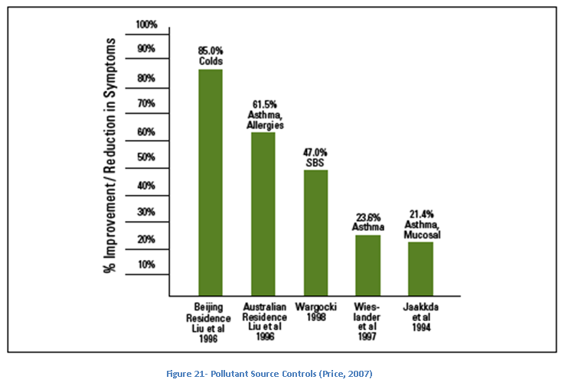
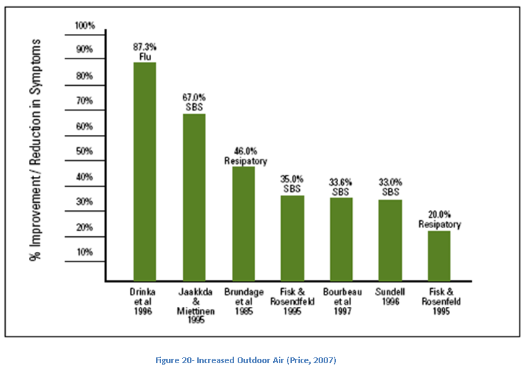
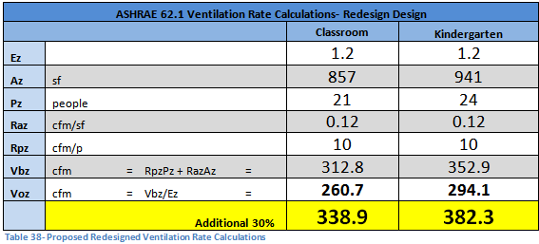
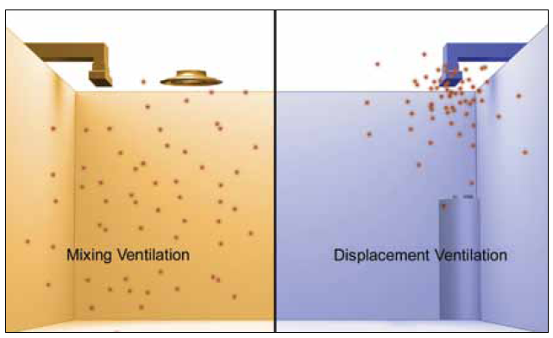
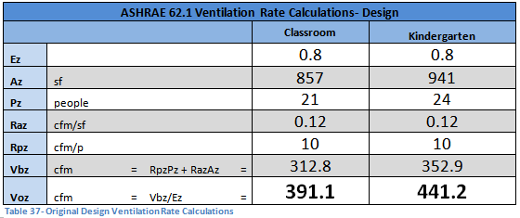
The Air Change Effectiveness (Ez) is increased to 1.2 allowing of 30% increased outdoor air while reducing CFM by 13%.
Increased Outdoor Air and contaminant controls greatly improves the indoor environment.
Presentation Outline
Project Overview
Existing Conditions
Depth
  Radiant Heating and Cooling
  Low Velocity Displacement Ventilation
Breadths
  Daylighting
  Acoustics
Overall Cost
  Initial Difference
  LCC
Pros versus Cons
(Price, 2007)

Slide 9
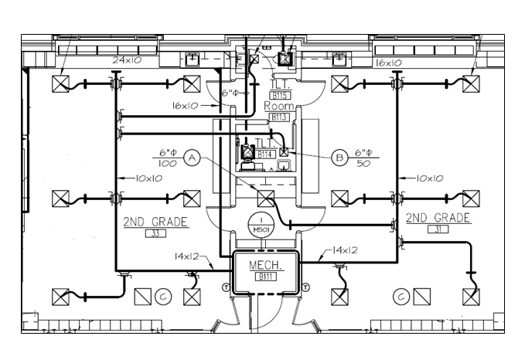
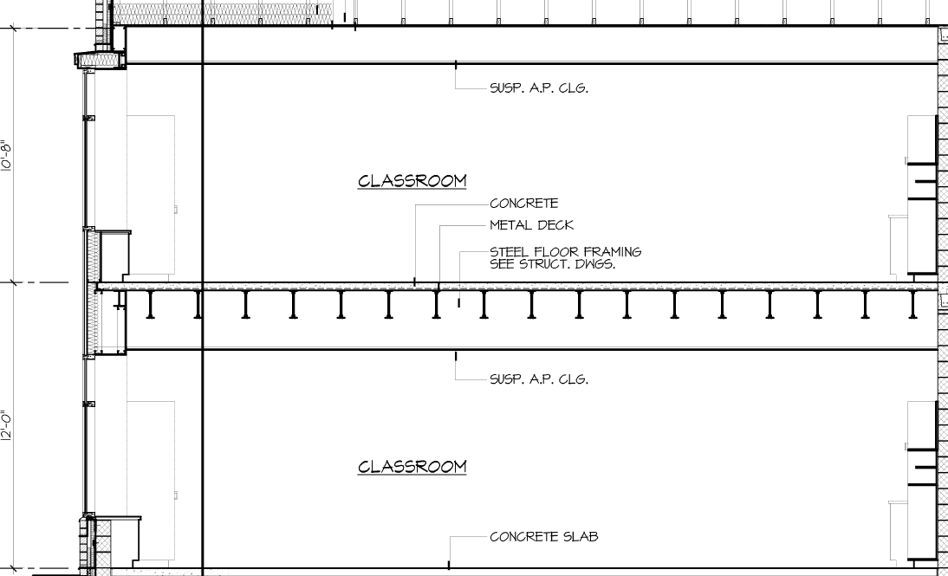
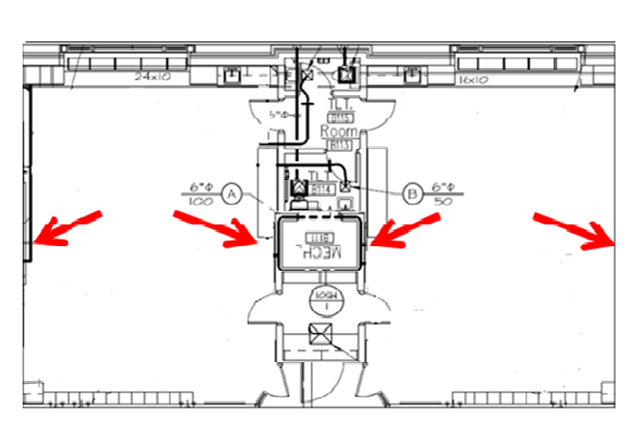
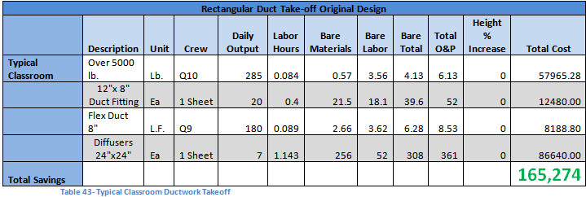
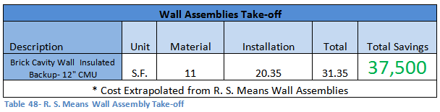
Additional benefits are added by reducing needed ductwork to typical classrooms.
Without the need for ductwork above the suspended ceiling building height can be lowered by 32”.
Presentation Outline
Project Overview
Existing Conditions
Depth
  Radiant Heating and Cooling
  Low Velocity Displacement Ventilation
Breadths
  Daylighting
  Acoustics
Overall Cost
  Initial Difference
  LCC
Pros versus Cons
Original Ductwork
Redesign Ductwork

Slide 10
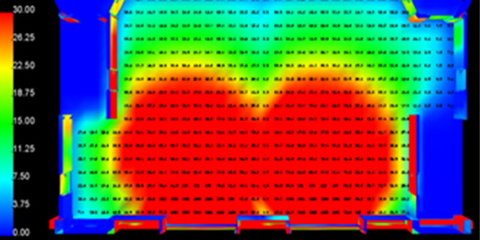
IESNA Lighting Design Guide the task of using a #2 pencil and softer leads is a performance of high contrast and large size.
The North facing classrooms receive less daylight then the South facing classrooms but still have dimming potential.
Presentation Outline
Project Overview
Existing Conditions
Depth
  Radiant Heating and Cooling
  Low Velocity Displacement Ventilation
Breadths
  Daylighting
  Acoustics
Overall Cost
  Initial Difference
  LCC
Pros versus Cons
Typical 1st Classroom South Sept. 21 at 12pm
Typical 2nd Classroom South Sept. 21 at 12pm
Typical 1st Classroom North Sept. 21 at 12pm
Typical 2ndClassroom North Sept. 21 at 12pm

Slide 11
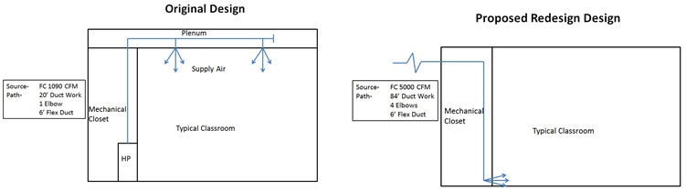
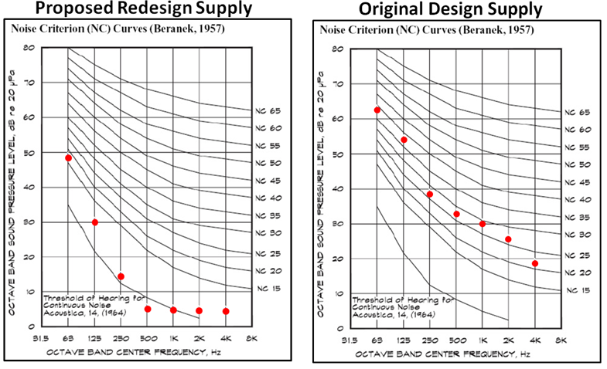
The redesign of the ventilation system changed the noise criteria rating of the air supply to the classrooms.
The noise criteria is reduced from a NC-39 to a NC-19 due to more attenuation within the duct work.
Presentation Outline
Project Overview
Existing Conditions
Depth
  Radiant Heating and Cooling
  Low Velocity Displacement Ventilation
Breadths
  Daylighting
  Acoustics
Overall Cost
  Initial Difference
  LCC
Pros versus Cons

Slide 12
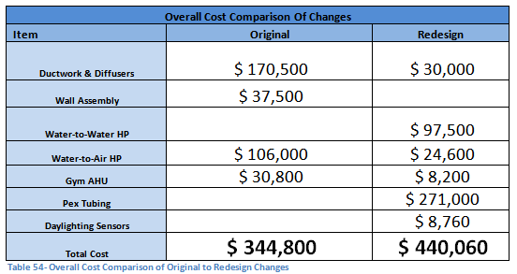
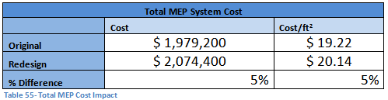
Using RS Means a cost comparison was calculated for all changes made to original design.
Overall the redesign was a 5% increase when compared to the initial cost.
Presentation Outline
Project Overview
Existing Conditions
Depth
  Radiant Heating and Cooling
  Low Velocity Displacement Ventilation
Breadths
  Daylighting
  Acoustics
Overall Cost
  Initial Difference
  LCC
Pros versus Cons

Slide 13
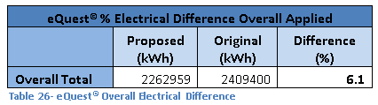
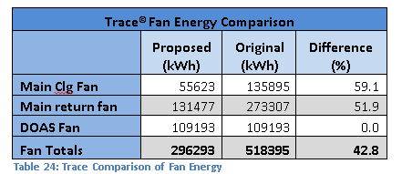
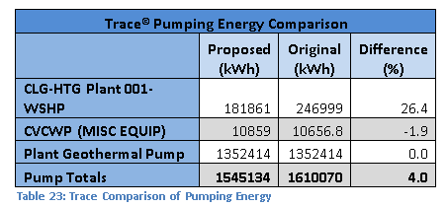
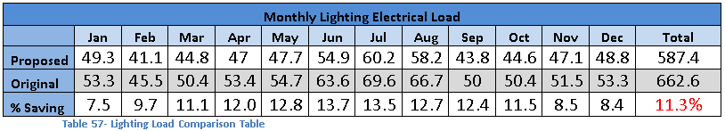
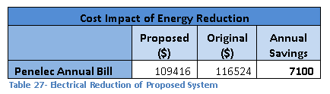
Annual Energy Savings of the proposed redesign compared to the original design were calculated.
The savings in electric were then calculated using the electrical rates supplied by the designer.
Presentation Outline
Project Overview
Existing Conditions
Depth
  Radiant Heating and Cooling
  Low Velocity Displacement Ventilation
Breadths
  Daylighting
  Acoustics
Overall Cost
  Initial Difference
  Life-Cycle Cost Analysis
Pros versus Cons

Slide 14
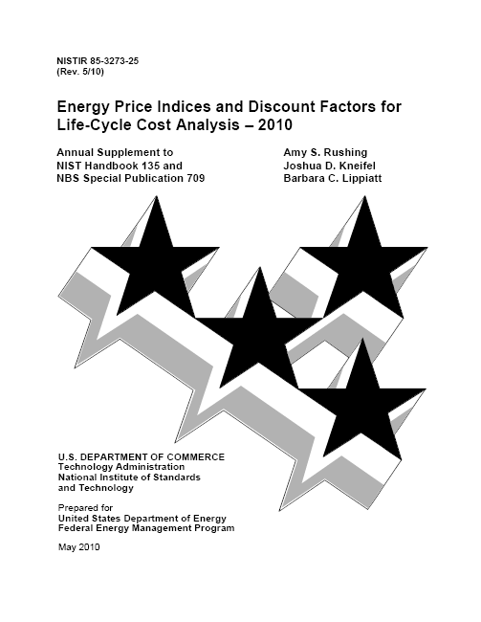
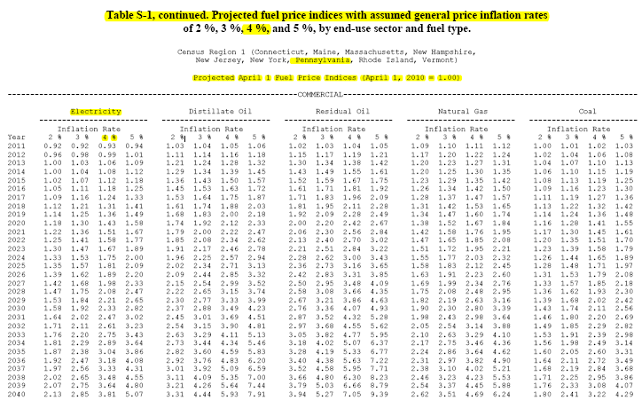
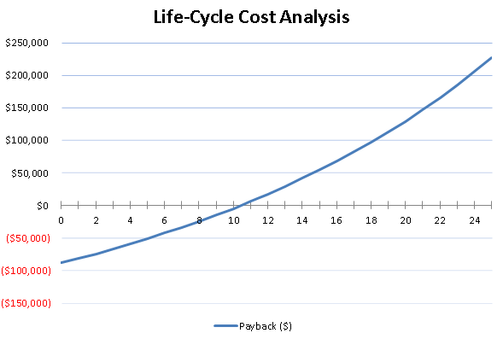
A Life-Cycle Cost Analysis was performed for the annual energy savings versus initial cost.
The Analysis showed a payback period of 10.5 years for the changes to the original design.
Presentation Outline
Project Overview
Existing Conditions
Depth
  Radiant Heating and Cooling
  Low Velocity Displacement Ventilation
Breadths
  Daylighting
  Acoustics
Overall Cost
  Initial Difference
  Life-Cycle Cost Analysis
Pros Versus Cons

Slide 15
The increase indoor environment is a major benefit of the proposed redesign.
Presentation Outline
Project Overview
Existing Conditions
Depth
  Radiant Heating and Cooling
  Low Velocity Displacement Ventilation
Breadths
  Daylighting
  Acoustics
Overall Cost
  Initial Difference
  LCC
Pros versus Cons
Pros
The redesign is considered to be feasible and is recommended.
Questions?
Con’s
5% Increased Initial Cost
Increased Construction Time
Increased IAQ
Contaminant Control
Warm Floor for Kindergarten
Increased Thermal Comfort
6% Energy Reduction
30% Increased Ventilation
Decreased Mechanical Noise
225K Payback over 25yrs
Reduced Absences
Increased Test Scores

